Slide 1
A Prophet on the Run Calling Upon the Lord in Time of Deep Distress
The Book of Jonah
March 26, 2023

Slide 2
Jonah 2:1-5
¹ Then Jonah prayed to the Lord his God from the stomach of the fish, ² and he said, “I called out of my distress to the Lord, and He answered me. I cried for help from the depth of Sheol; You heard my voice. ³ “For You had cast me into the deep, into the heart of the seas, and the current engulfed me. All Your breakers and billows passed over me. ⁴ “So I said, ‘I have been expelled from Your sight. Nevertheless I will look again toward Your holy temple.’ ⁵ “Water encompassed me to the point of death. The great deep engulfed me, weeds were wrapped around my head.

Slide 3
Jonah 2:6-10
⁶ “I descended to the roots of the mountains. The earth with its bars was around me forever, but You have brought up my life from the pit, O Lord my God. ⁷ “While I was fainting away, I remembered the Lord, and my prayer came to You, Into Your holy temple. ⁸ “Those who regard vain idols forsake their faithfulness, ⁹ But I will sacrifice to You with the voice of thanksgiving. That which I have vowed I will pay. Salvation is from the Lord.” ¹⁰ Then the Lord commanded the fish, and it vomited Jonah up onto the dry land.

Slide 4
A Prophet on the Run
I. Sovereign to Send
II. Sovereign to Save
III. Sovereign to Spare
IV. Sovereign to Scold

Slide 5
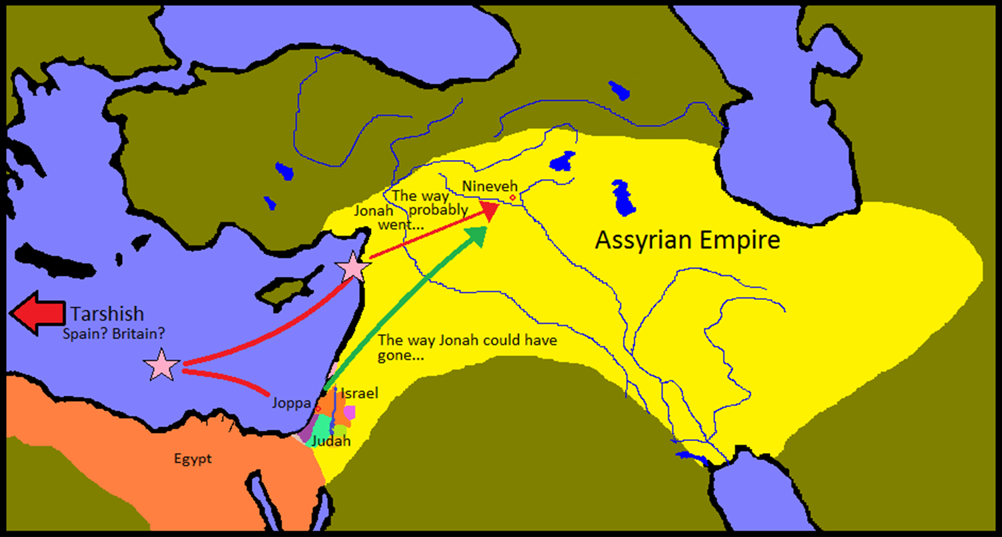
A Prophet on the Run

Slide 6
A Prophet on the Run
II. Sovereign to Save (2:1-10)
A. The Petition (2:1-4)

Slide 7
Called out to God
I called out of my distress to the Lord (2:2a)
I cried for help from the depth of Sheol (2:3b)
“Called and Cried” indicate past and completed action
“Called” from 2:2 is the same verb from 1:14 when the sailors “called” upon the Lord earnestly.

Slide 8
Thought
You shall always feel the presence of the Lord; whether it is a blessing or a chastisement, His presence is no closer or farther from you, believer, regardless of your circumstance. The deciding factor is your holiness or your sinfulness.

Slide 9
A Prophet on the Run
II. Sovereign to Save (2:1-10)
A. The Petition (2:1-4)
B. The Provision (2:5-7)

Slide 10
A Prophet on the Run
II. Sovereign to Save (2:1-10)
A. The Petition (2:1-4)
B. The Provision (2:5-7)
C. The Praise (2:8-10)

Slide 11
Psalm 50:14-15
Offer to God a sacrifice of thanksgiving and pay your vows to the Most High; call upon Me in the day of trouble; I shall rescue you, and you will honor Me.

Slide 12
Thought
Jonah is swallowed (1:17a)
Jonah spends 3 days and 3 nights in the belly of the fish (1:17b)
Jonah spends time reflecting and praying over his actions of remembering his God (Chapter 2)
Jonah repents of his sinful rebellion with the proclamation “Salvation is from the Lord” (2:9b)

Slide 13
A Prophet on the Run Calling Upon the Lord in Time of Deep Distress
The Book of Jonah
March 26, 2023

